Slide 1







ROAD SIGNS CLASSIFICATION
Milestone – 3
ARUN RAJ
Presented
by
ARUN RAJ V

Slide 2









Used Technologies
Tensorflow
python
Deep learning model

Slide 3
Model Architecture
Input
128 x 128 x1
Convolution 1
32 - 3 x 3
Max Pooling
2 x 2
Convolution 2
64 - 3 x 3
Max Pooling
2 x 2
Output
Flatten
Dense Layer
Max Pooling
2 x 2
Convolution 3
128 – 3 x 3

Slide 4
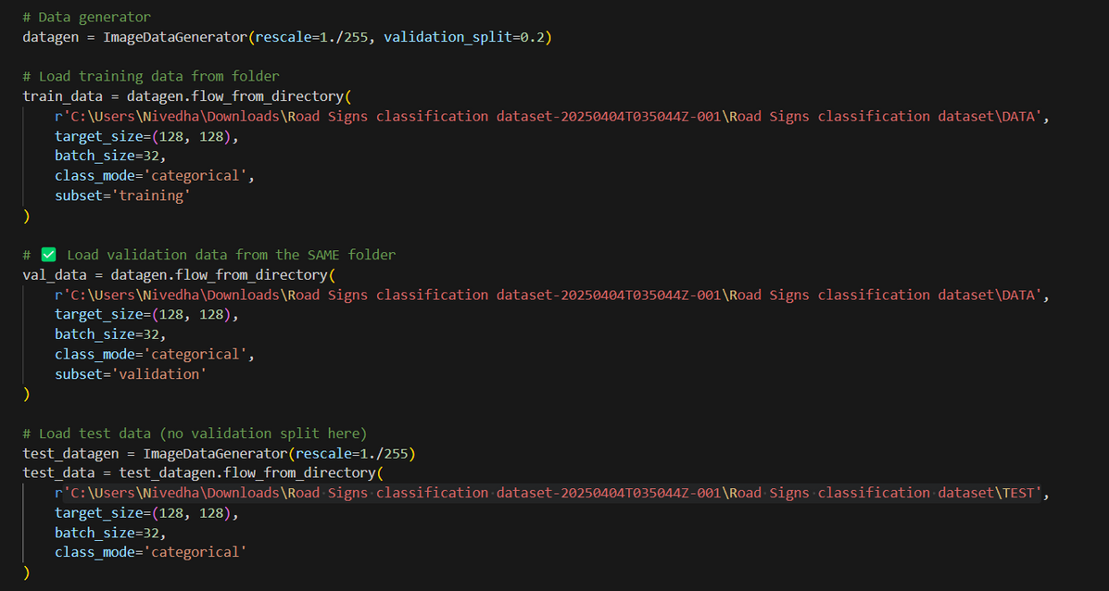
Reading Data

Slide 5
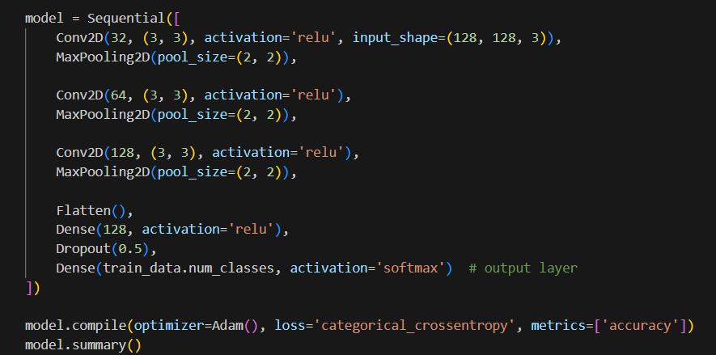

Model Creation
and compilation

Slide 6
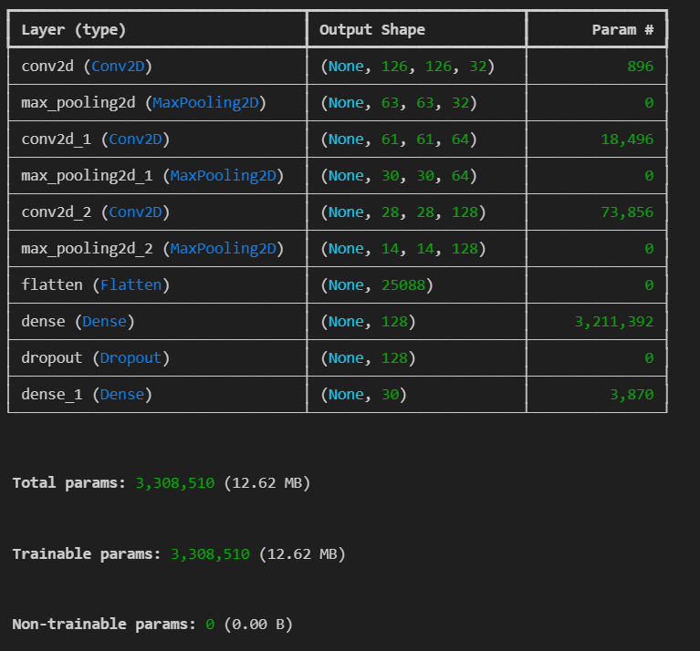

Model Summary
T

Slide 7
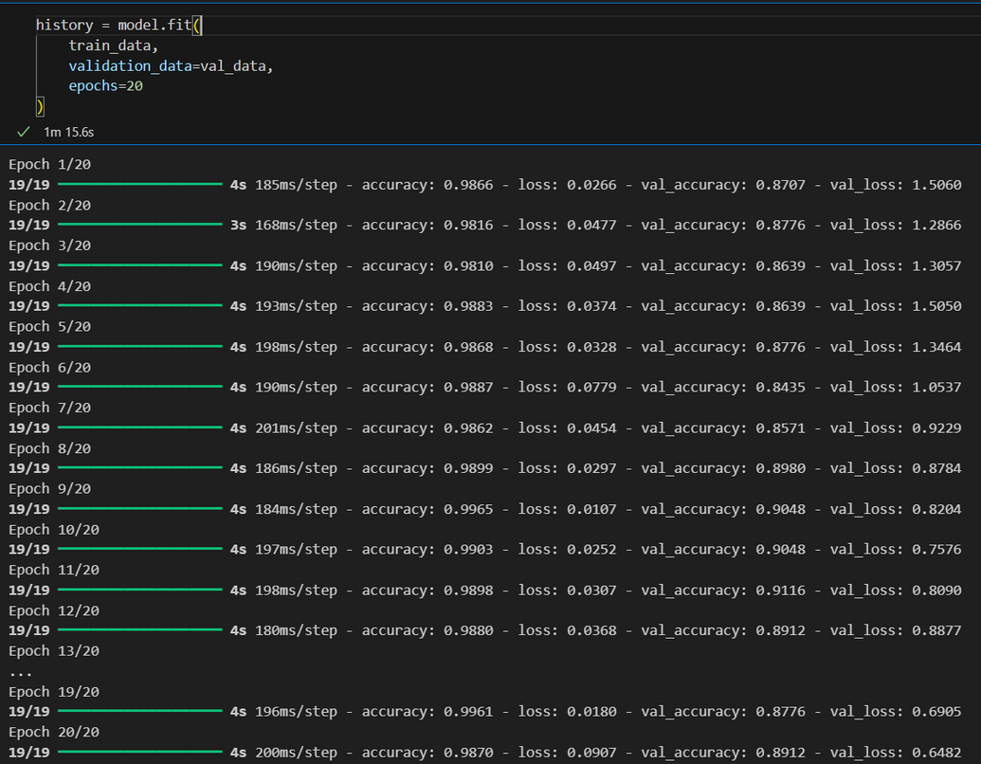
Model Performance

Slide 8
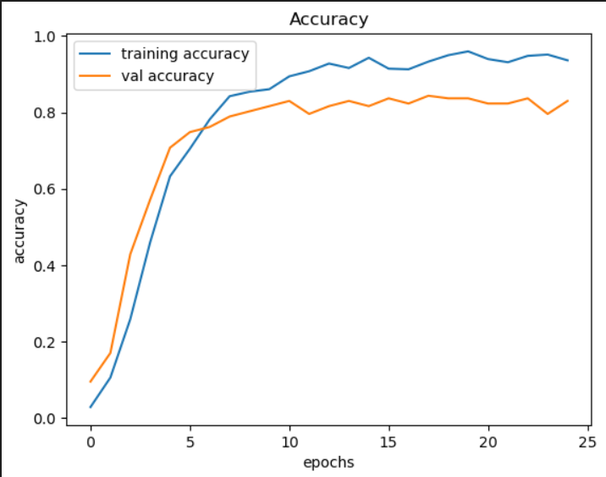
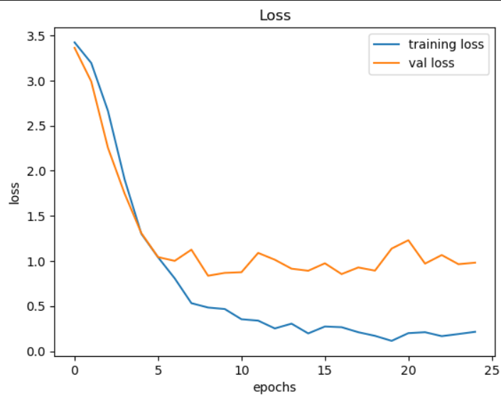
Performance Indicator

Slide 9

Thank You

